Slide 1
Bank Marketing
Classification
December 19

Slide 2
Table of contents
01
Introduction
02
Design
03
Exploratory Data Analysis
04
Algorithms
05
Models
06
Tools

Slide 3
01
Introduction

Slide 4
Introduction
The data is related with direct marketing campaigns (phone calls) of a Portuguese banking institution.
The classification goal is to predict if the client will subscribe a term deposit (variable y).
Business Problem:
predict the success of a bank marketing campaign based on the features we have in out data. This project should therefore help us be better able to identify potential customers and refine our the focus of future campaigns.

Slide 5
02
Design

Slide 6
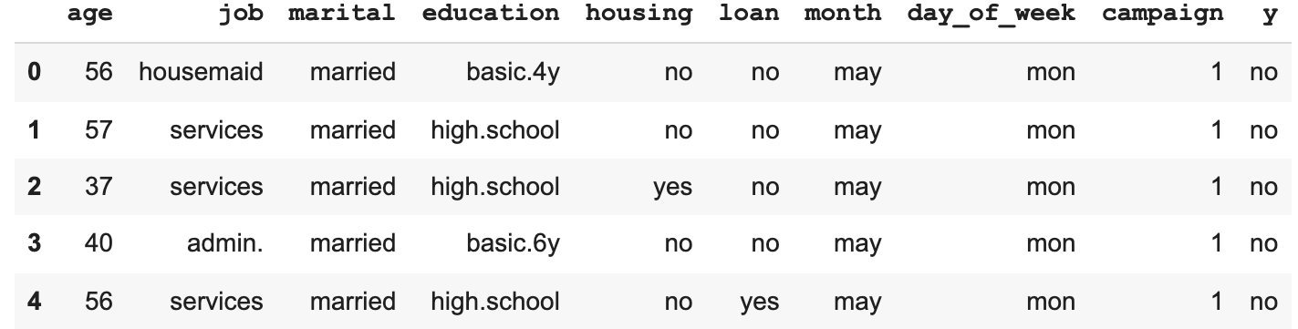
Dataset
Dataset source:
From Kaggle website [Kaggle]
Size of Data:
Number of rows: 41188
Number of columns: 21

Slide 7
Challenges
2. Imbalance data
1. Drop unknown variables
4. Long time to run
3. Find a best model

Slide 8
03
Exploratory Data Analysis

Slide 9
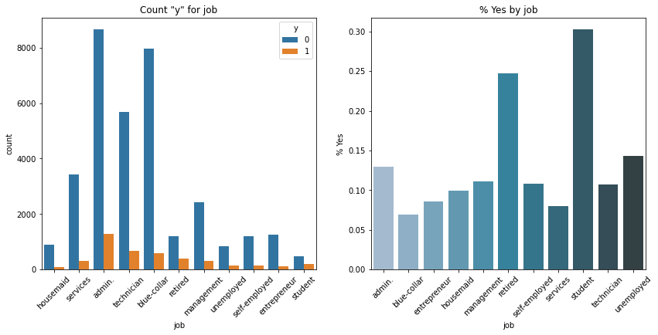
Counts of categorical variables

Slide 10
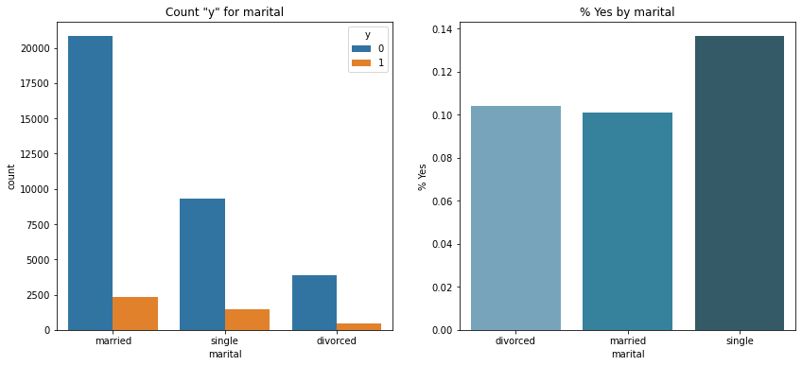
Counts of categorical variables

Slide 11
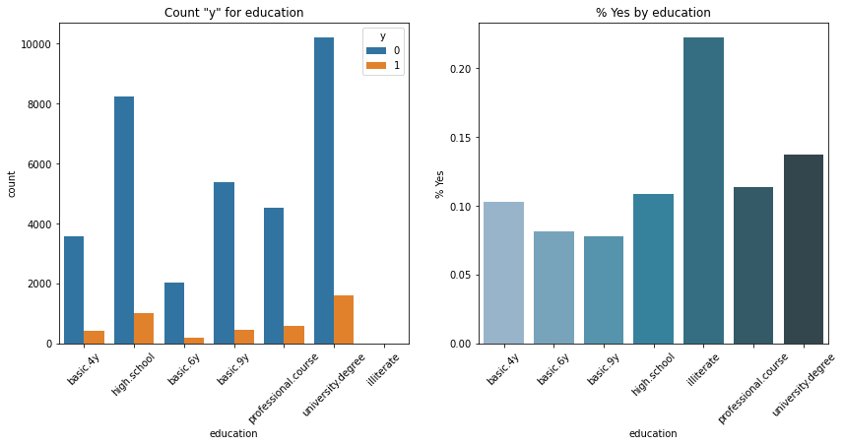
Counts of categorical variables

Slide 12
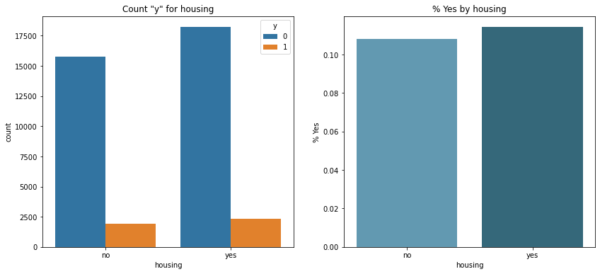
Counts of categorical variables

Slide 13
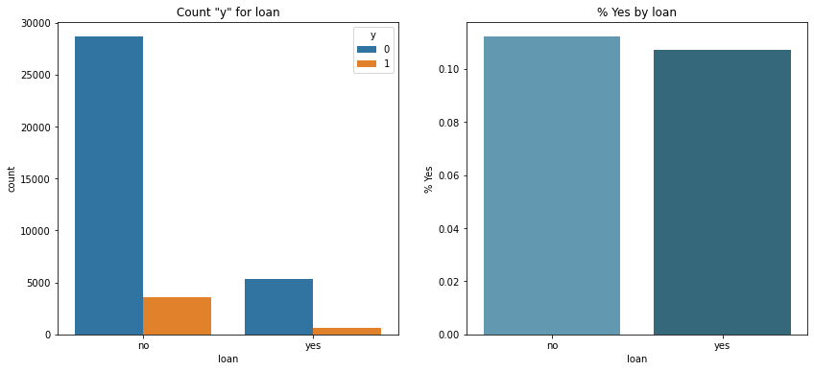
Counts of categorical variables

Slide 14
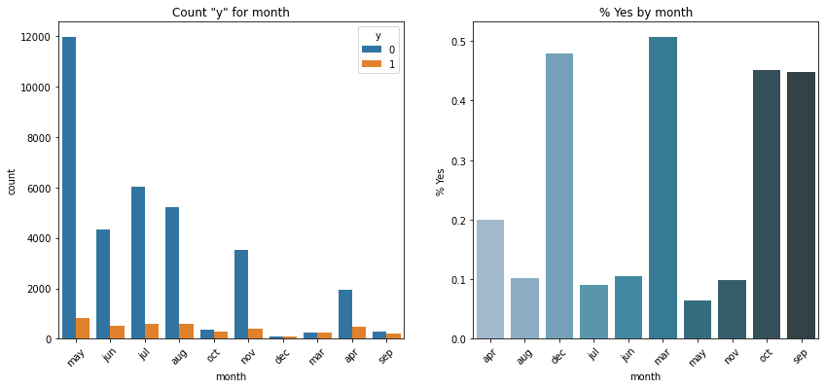
Counts of categorical variables

Slide 15
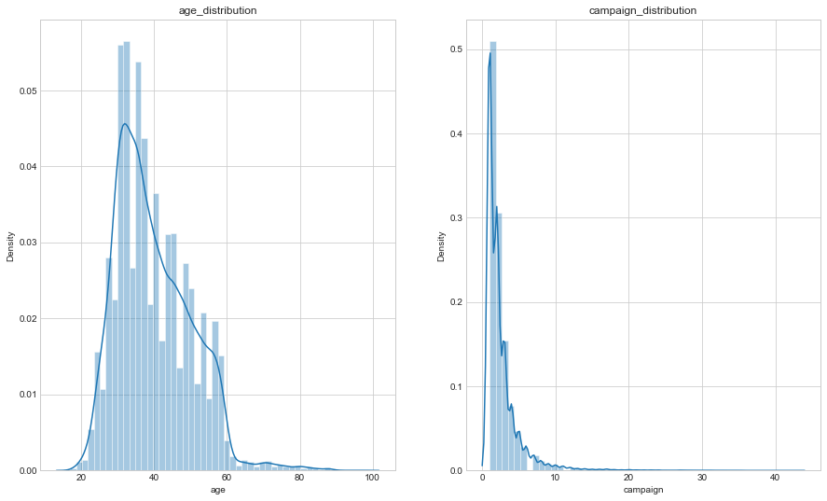
Distributions of continuous variables

Slide 16
04
Algorithms

Slide 17





Algorithms
Logistic Regression
k-Nearest Neighbours
Decision Tree
Random Forest
XGBoost

Slide 18
05
Models

Slide 19
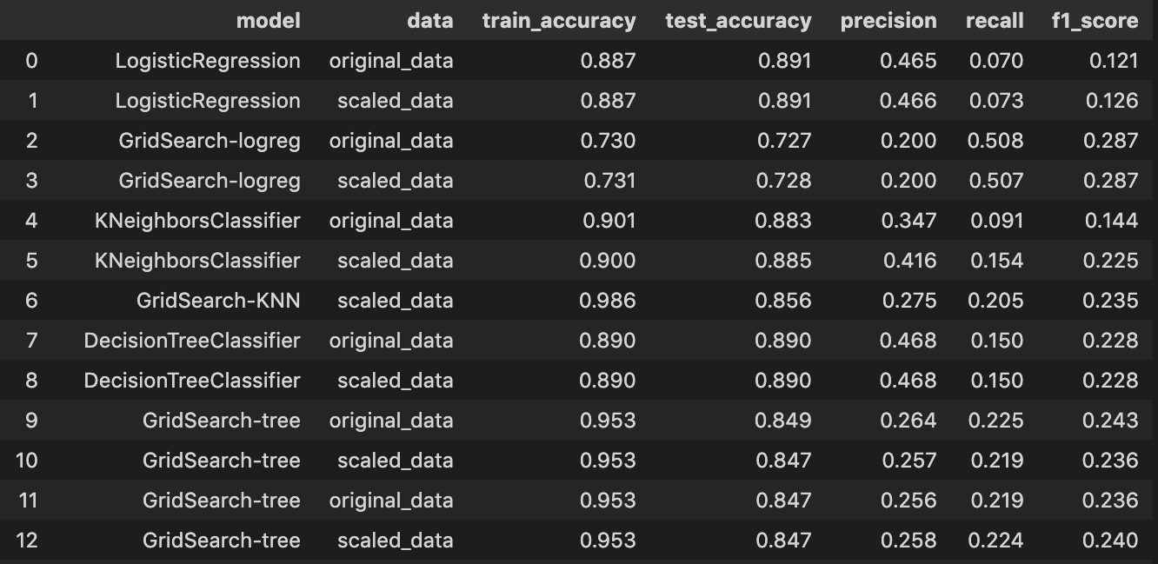
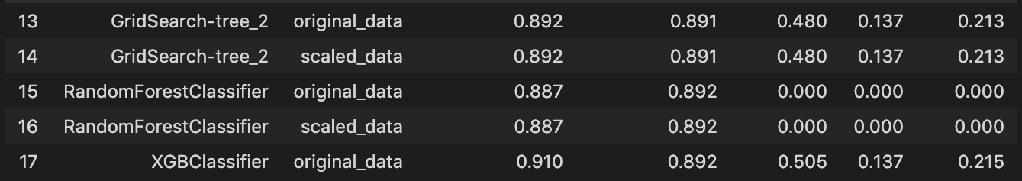
Models

Slide 20
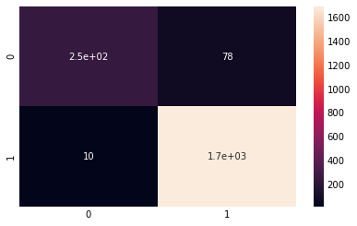
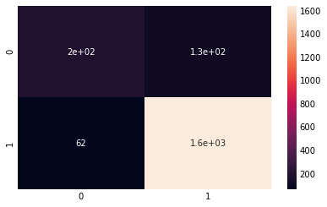
XGBoost
LR

Slide 21
06
Tools
VScode
PowerPoint
Python
GitHub
Zoom

Slide 22
Conclusions
in order to successfully achieve the purpose of the marketing process, the banks should:
-perform analyses in order to know the bank customers to the highest possible extent

Slide 23
Thanks!!
Do you have any questions?
Shaima Alzahrani
Nasser Alquraini
Raghad Alnasser

